Slide 1
多色流式分析工作坊-
配色秘訣、上機設定全攻略
Kate Chen
Product specialist
2019.05.09

Slide 2
Workshop agenda
7/25 | 課程名稱 | 課程內容
09:00-09:45 | Multi-color dig into a new world | 多色實驗優勢，趨勢與設計原理介紹
09:45-10:30 | Brilliant dye - a better tool for you | 介紹Brilliant dye家族螢光與螢光特性、試用時機與數據實例
10:30-10:50 | Break
10:50-12:00 | Workshop: Multi-color design practice | 多色實驗設計實作 GPS範例
12:00-13:30 | Lunch
13:30-14:00 | Good practice of cell staining & compensation control | 細胞染色細節與技巧 染色控制組之設計
14:00-15:30 | Cell staining | 學員動手做 多色實驗+控制組
15:30-18:00 | Compensation, data acquisition | 螢光補償與數據收取；分組上樣
總上課時間: 一天
課程內容:
多色原理
GPS設計配色
染色與上機實作
染色由學員動手操作，
加入染色控制組，幫助結果判讀

Slide 3
Workshop 規劃
日期: 2019/07/25
地點: 高雄醫學大學 資源中心
預計參與學員人數: 24人
實作分組: 6人/組，共四組
BD GPS線上配色系統教學 (請學員攜帶筆電)
染色樣本: BD Dri Leukocyte (凍乾 hPBMC)
分析目標族群: Treg

Slide 4
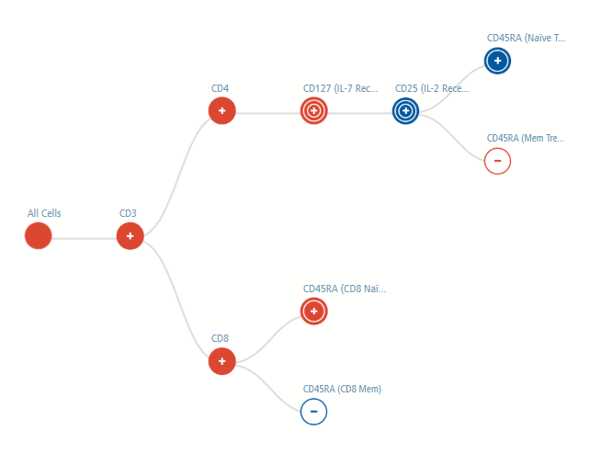
Treg markers and subpopulation
Markers included in this panel:
CD3
CD4
CD8
CD127
CD25
CD25RA
CD127^{dim}CD25⁺ Treg
CD127^{dim}CD25⁺CD45RA⁺ Naïve Treg
CD127^{dim}CD25⁺CD45RA⁻ MemoryTreg
CD8 Naïve
CD8 Memory

Slide 5
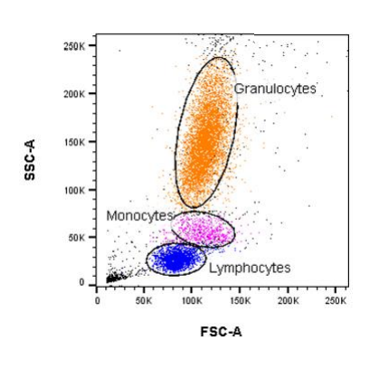
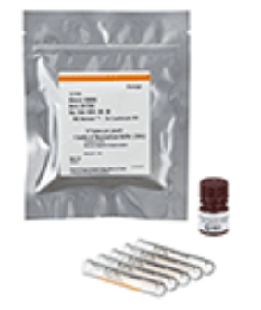
Auxiliary reagents staining sample-Dri Leukocyte
BD Horizon™ Dri Leukocyte
Cell count: 2 x 10⁶ to 3 x 10⁶ cells per tube (Dried lysed whole blood cells)
Stability: 12 months from manufacturing date, 5 days after reconstitution
Package: 5 tubes and 1 vial of reconstitution buffer (3 mL)
200

Slide 6
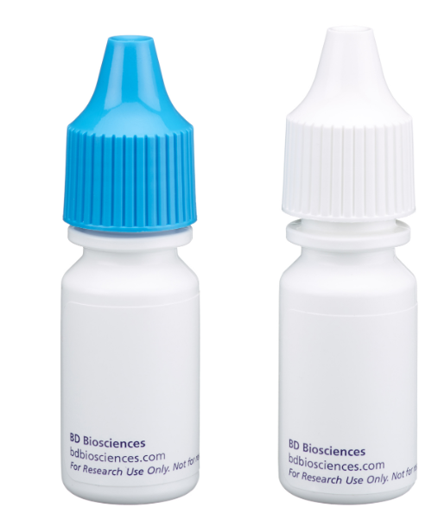
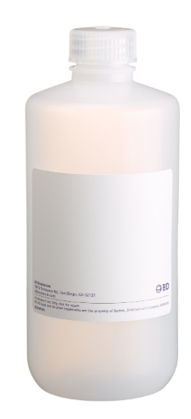
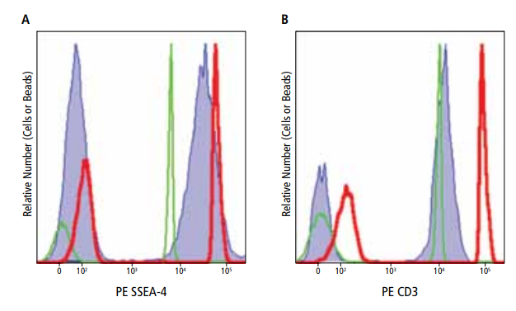
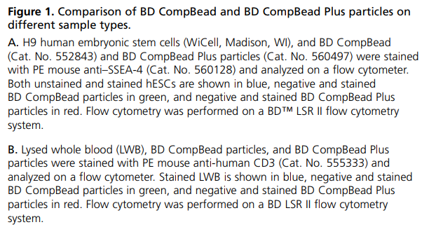
Auxiliary reagents compensation beads, stain buffer
BD™ CompBead Anti-Mouse Ig, κ/Negative Control
Cat. No. 552843
Ideal for experiments with
dimly expressed antigens
antibodies that have low affinity for receptors on the cell surface
rare cells for saving samples
Stain Buffer (FBS)
500 mL
Cat. No. 554656
Stain Buffer (FBS) can be used for the immunofluorescent staining of single-cell suspensions prepared from either lymphoid tissues, bone marrow, peripheral blood, or cultured cells. Stain Buffer (FBS) is useful for the dilution and application of fluorescent reagents
cells
compbeads
compbeads plus

Slide 7
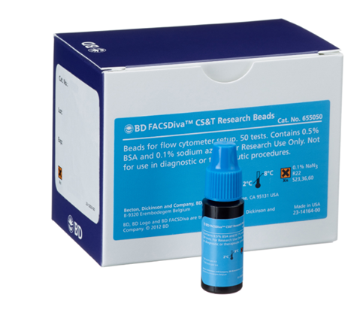
DIVA Software QC system: CS&T beads
CST (Cytometer Setup and Tracking)
Diva軟體內建儀器設定與品管系統, 搭配標準品微珠
1.自動校正儀器設定
2.檢查偵測器效能
3.追蹤雷射與偵測器表現
4.提供儀器健康報告
5.協助解決實驗疑難
6.利於儀器間平行測試相容

Slide 8
CS&T QC report
各偵測器線性度/CV值/電壓值比對差值
提供偵測器長期追蹤
為雷射與偵測器效率指標

Slide 9
LSRII configuration
Lasers | Fluorochrome
405 nm Violet laser | BV421
 | BV510
 | BV605
488 nm Blue laser | FITC, Alx 488, BB515
 | PerCP, BB700
561 nm Yellow Green laser | PE
 | PE-Texas Red
 | PE-Cy5
 | PE-Cy5.5
 | PE-Cy7
633 nm Red laser | APC
 | APC-R700
 | APC-Cy7

