Slide 1
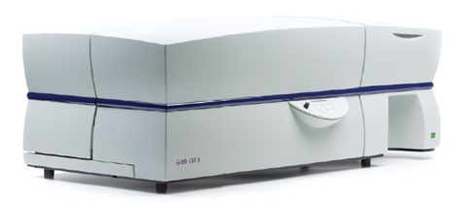
Introduction to Flow Cytometry
Theory and Applications
Tony Liu 劉聖德 (tony.liu@bd.com)
Product Manager
BD Biosciences Taiwan

Slide 2
What is Flow Cytometry?
Flow = Fluid
Cyto = Cell
Metry = Measurement
A variety of measurements are made on cells, cell organelles, and other objects suspended in a liquid and flowing at rates of several thousands per second through a flow chamber.

Slide 3
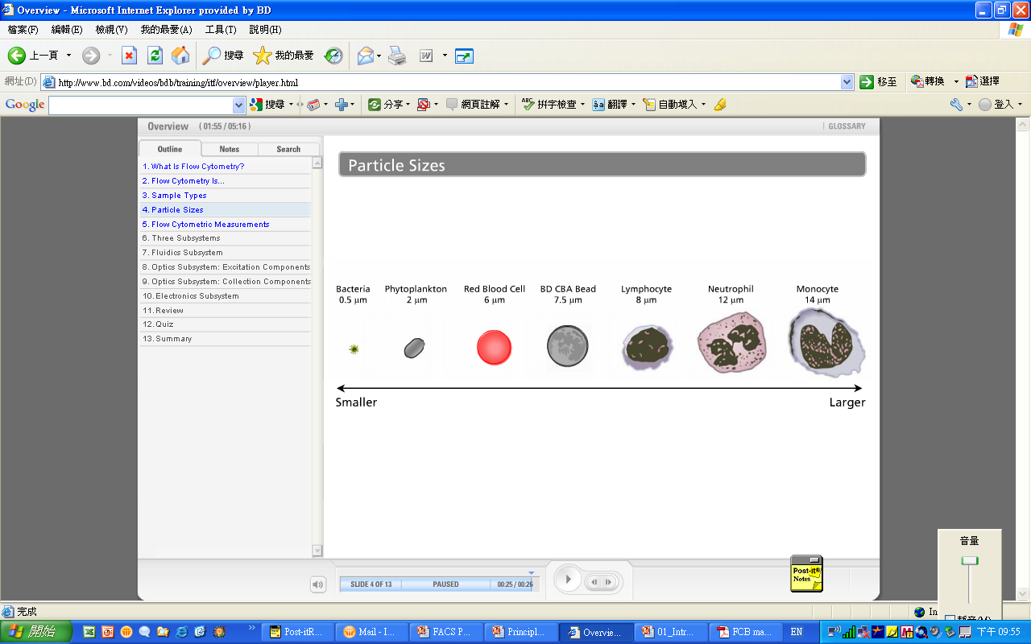
Particle Size
Detection range: 0.5~50um

Slide 4
What Can a Flow Cytometer Tell Us About a Cell?
Its relative size (Forward Scatter—FSC)
Its relative granularity or internal complexity
(Side Scatter—SSC)
Its relative fluorescence intensity
Notes:
From the pre-training exercises or through your own experience you should be able to answer the following questions:
Answers:
FSC measures relative size of a particle (diffracted light)
SSC measures relative granularity or internal complexity of a particle (reflected or refracted light)
Excitation and emission spectra of your fluorochromes are important so that you can ensure that you have the appropriate optical configuration (lasers, filters) on your system to measure sample data.
Voltage pulses can be analyzed in terms of their area, height, and width

Slide 5
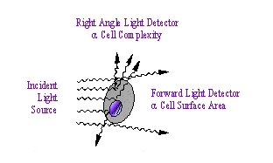
Scatter Light
Flow Cell
Laser
Obscuration bar
FSC Sensor
SSC Sensor
Notes:
Obscuration bar = 遮光板

Slide 6
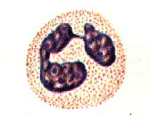
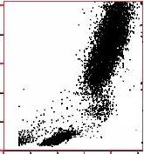
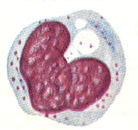
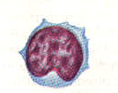
Lysed Whole Blood
Neutrophils
Side Scatter
Monocytes
Forward Scatter
Lymphocytes
Notes:
X Axis = Forward Scatter
Y Axis = Side Scatter

Slide 7
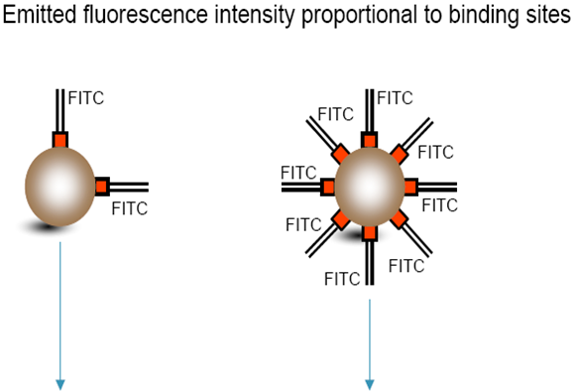
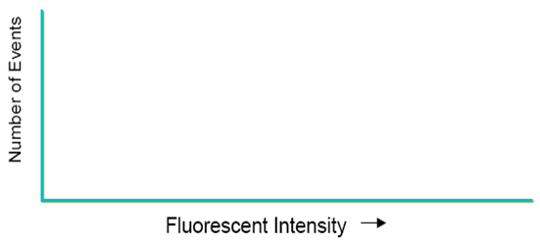
Fluorescence

Slide 8
Flow Cytometer Subsystems
Fluidics
To introduce and focus the cells for interrogation.
Optics
To generate and collect the light signals.
Electronics
To convert the optical signals to proportional digital signals, process the signals, and communicate with the computer.
Notes:
Let’s also review the three subsystems in a cytometer and their respective functions:
Fluidics provide a means of delivering the sample to the viewing area, or flow cell.
Optics consist of a light source, focusing optics, and a means of collecting different wavelengths of light.
Electronics convert optical signals to voltage pulses and supply the computer with data representing the sample.

Slide 9
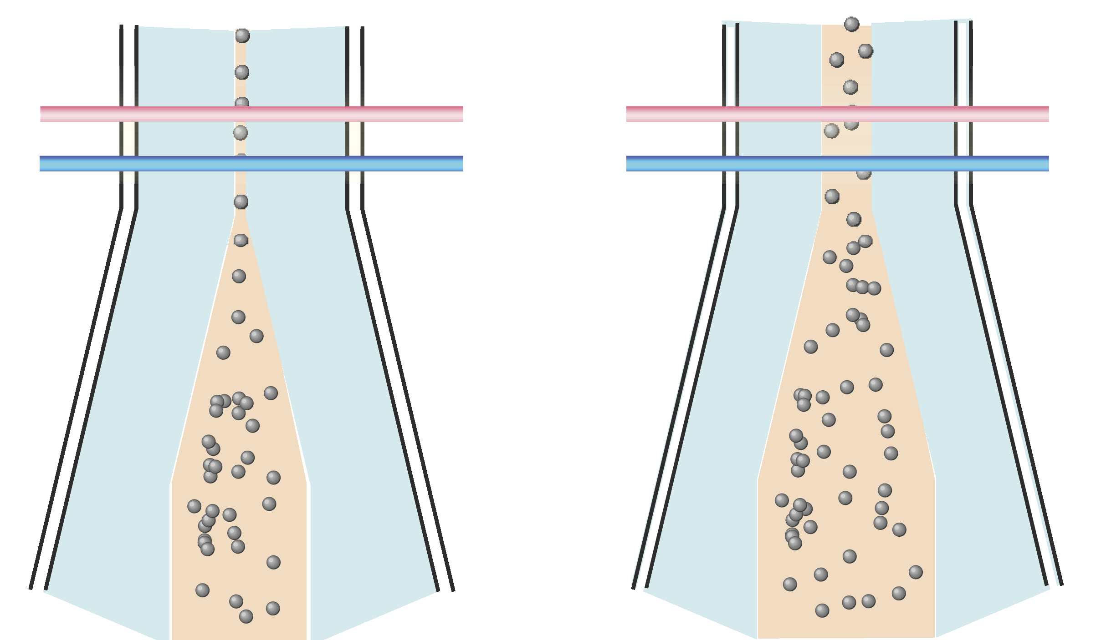
Sample Flow
Hydrodynamic Focusing
Excitation Lasers
Flow Cell
sheath
sheath
sample
Notes:
Now let’s look closer at what happens as sample and sheath fluid are introduced in the flow cell:
When you place a test tube on the cytometer, sample travels up the sample injection tube (SIT) in a separate, pressurized stream. It arrives in the lower chamber of the flow cell at a slight overpressure relative to the sheath fluid. The conical shape of the lower chamber creates a laminar sheath flow that carries the particles upward in single file through the center of the flow cell, where they are intercepted by the laser beam.
The difference in pressure between the sample stream and sheath fluid stream can be used to vary the diameter of the sample stream, also known as the sample core. Increasing the sample pressure increases the core diameter and therefore the flow rate.
Q: What else do you observe here with the different sample pressures?
A: Higher frequency of events, many events traveling past laser simultaneously.
A higher flow rate is generally used for measurements such as immunophenotyping. The data is less resolved but is acquired more quickly.
A lower flow rate is generally used in applications where greater resolution is critical, such as DNA analysis.
Q: What problems would you expect to see if there were air bubbles or debris in your flow cell?
A: Weird populations or erratic shifting in light scatter plots, or no events.

Slide 10
Sample Differential
Low Differential Pressure
High Differential Pressure
Low Sample Pressure
12 µL/min
High Sample Pressure
120 µL/min
Laminar
Flow
Laminar
Flow
Sheath
Sheath
Sheath
Sheath
Sample
Sample
Notes:
The phenomenon of hydrodynamic focusing takes place when a fluid is introduced into the center of another fluid then forced through a pathway of diminishing volume. This accelerates and focuses the fluids.
In the viewing area where the walls are parallel, the fluids go in a layered fashion called laminar flow.
In low sample pressure, the sample stream is narrow and the cells will tend to go in a single file.
The sample is flowing at a rate of 12uL/min.
In high sample pressure, the sample stream is much wider, allowing more cells to go through the flow cell.
The speed that the cells go through the flow cell is the same as in low flow rate, but the quantity of cells is greater due to the wider stream.
The sample is flowing at a rate of 60uL/min.
In the FACSCalibur there is a medium sample rate of 35uL/min.
Debrief #2
Q. What problems would you expect to see if there was an air bubble or debris in the flow cell?
Answer: You would get turbulence that would cause events to move on the computer screen and the event rate would go down.
Q. What do you think would happen if the sheath cap was not on tight?
Answer: Sheath pressure would not be stabilized at 4.5 psi and the pressure differential would not be optimal, therefore the sample stream would not be stable.
This completes the fluidics portion of this lecture. We discussed the way that the sheath and sample get to the flow cell. We also looked, in detail, at what goes on inside the flow cell.

Slide 11
BD LSR II Optical System
Excitation optics:
  Lasers
  Filters and mirrors that route the laser light to the fluid stream
Collection optic:
  Fiber optic cables that direct the emitted light to the appropriate emission block
  Filters that direct the signals in the emission block to the appropriate photomultiplier tube (PMT)
Notes:
Read slide.

Slide 12
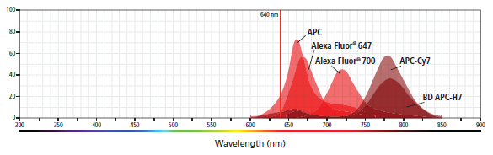
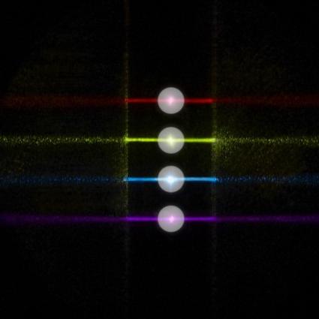
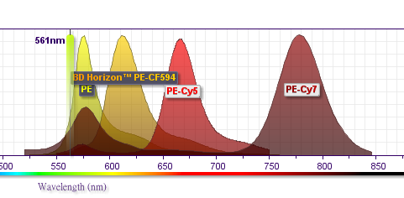
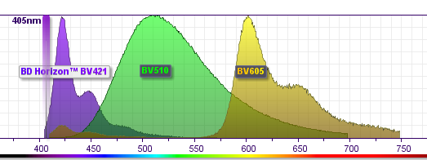
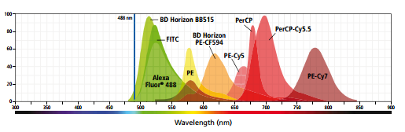
LSR II Optics (4 Lasers, 13 Colors)

Slide 13
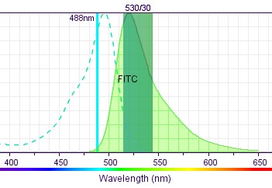
Excitation and Emission
Use the maximum excitation wavelengths to determine lasers that can be used to excite the fluorochrome.
Use the maximum emission wavelengths to determine filters and PMTs that can be used to measure the signal.
www.bdbiosciences.com/spectra
Notes:
Each fluorochrome can be further characterized by excitation and emission spectra.
Read slide
1st bullet: point to blue line in the graph indicating blue laser is good at exciting FITC
2nd bullet: point to 530/30 filter and how it’ close to emission peak of the FITC and that’s why an appropriate choice fo the filter.
We will later in this class show you a great tool to visualize these curves for all fluorphores.

Slide 14
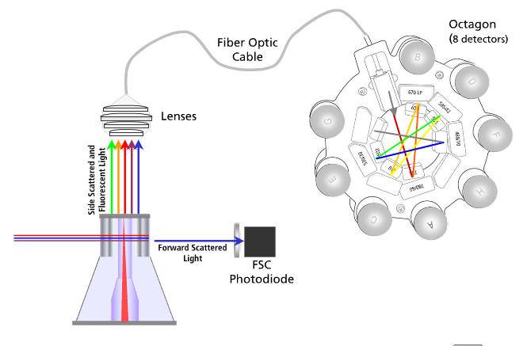
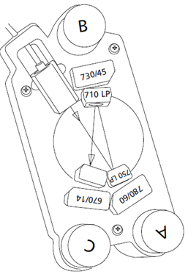
Collection Optics
Trigon
(3 detectors)

Slide 15
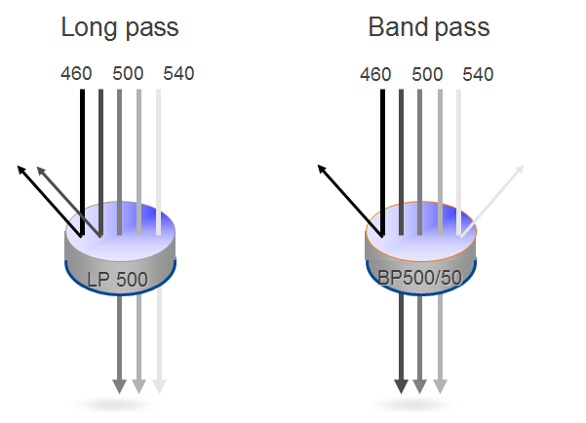
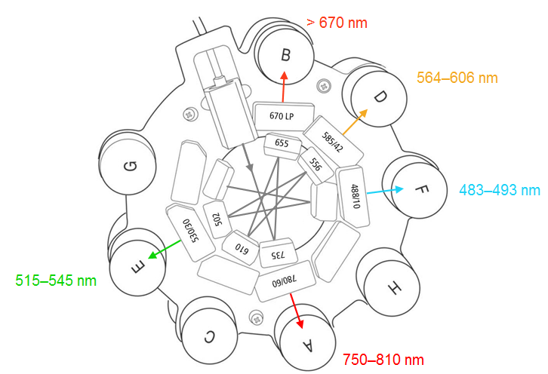
Optical Filters
Octagon
Notes:
There are different types of filters in the optics system. Here’s a brief description of two of the filter types.
A longpass (LP) filter has the ability to allow wavelengths equal to or longer than the rated value to pass through the filter while wavelengths shorter than the specified wavelength are reflected off.
A bandpass (BP) filter combines the properties of both filters, giving you the ability to select a given bandwidth to be delivered to the detector. This example 500/50, will pass wavelengths of 500 +/- 25.

Slide 16
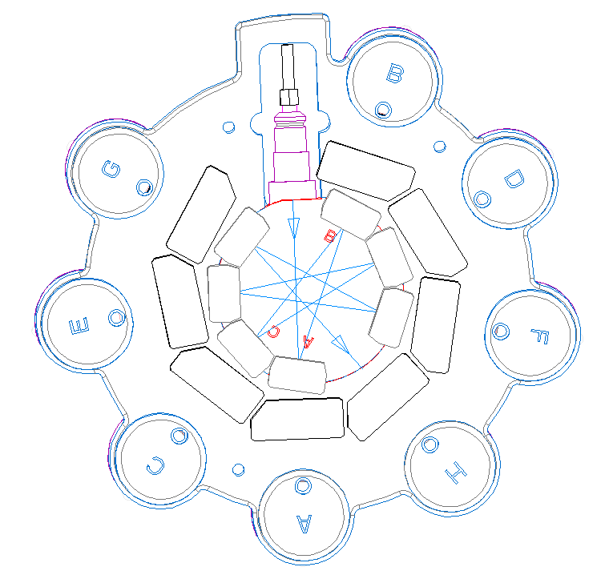
488nm Blue Laser (2 Colors)
Basic laser which is equipped in almost all Flow Cytometers
Generates FSC/SSC
Example fluorochromes excited:
    FITC, Alexa488, GFP, CFSE
    PerCP and PerCP tandems

Slide 17
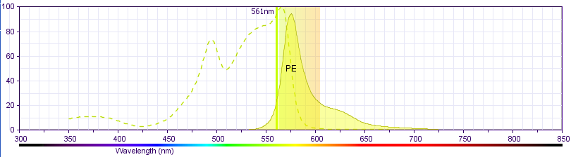
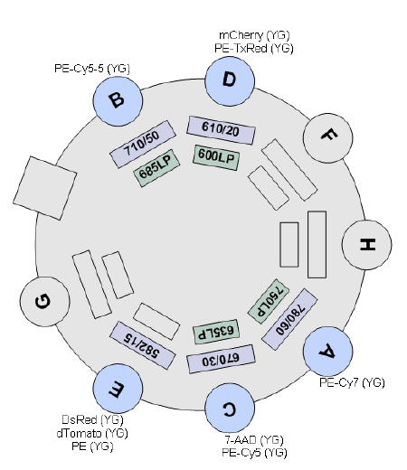
561nm Yellow-Green Laser (5 Colors)
Closest wavelength to PE excitation peak, provides better sensitivity to PE and PE tandems
No spillover from FITC
Example fluorochromes excited:
    PE
    PE-Texas Red
    PE-Cy5
    PE-Cy5.5
    PE-Cy7
Optimal excitation for DsRed, mCherry, RFP, and other fruit proteins
561nm is close to the PE max. excitation peak

Slide 18
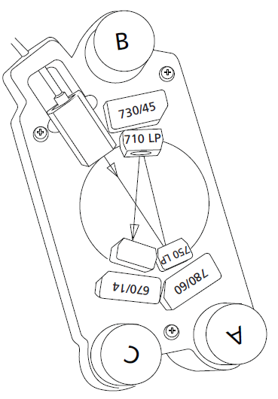
640nm Red Laser (3 Colors)
Example fluorochromes excited:
    APC, Alexa Flour 647
    Alexa Flour 700
    APC-Cy7, APC-H7

Slide 19
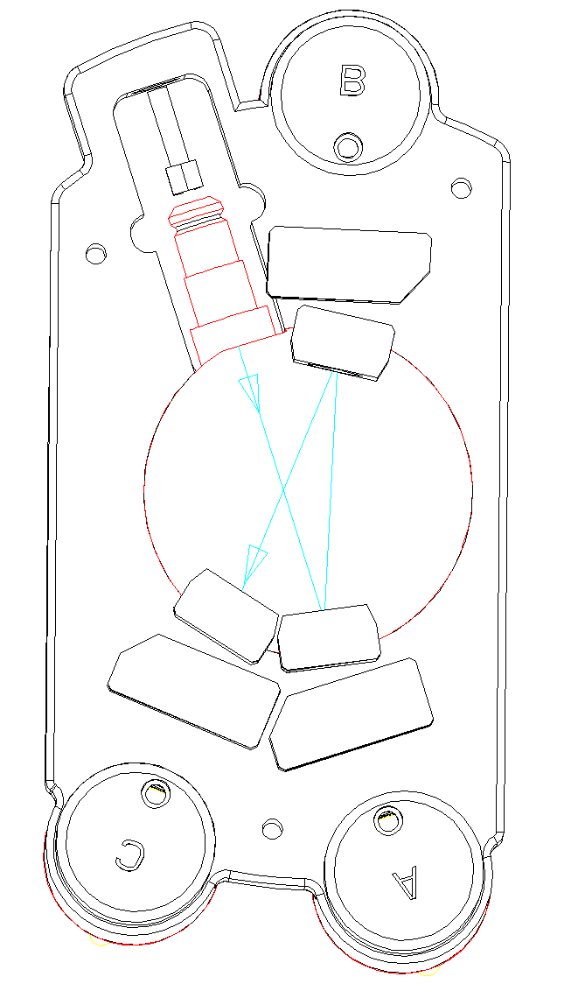
405nm Violet Laser (3 Colors)
Ideal for Brilliant Violet (BV) dyes
  BV421
  BV510
  BV605

Slide 20
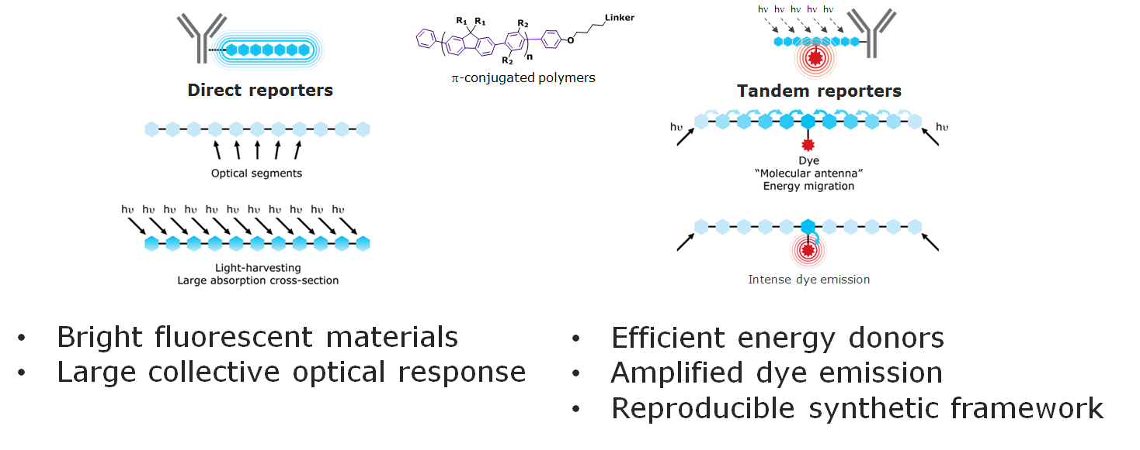
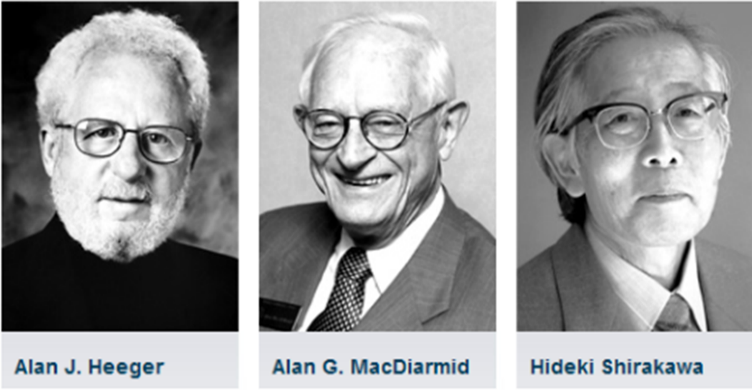
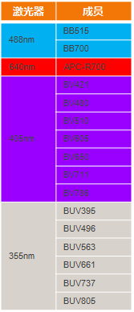
Sirigen Dyes-Nobel Prize recognized in Year 2000
Nobel Prize Winners in Year 2000
16 Sirigen series
BD unique
  UV laser-6 BUV dyes
  Violet Lase-7 BV dyes
  Blue laser-2 BB dyes
  Red Laser-APC-R700
  OptiBuild-customized dyes
Excellent for rare cell populations
Light up your cells

Slide 21
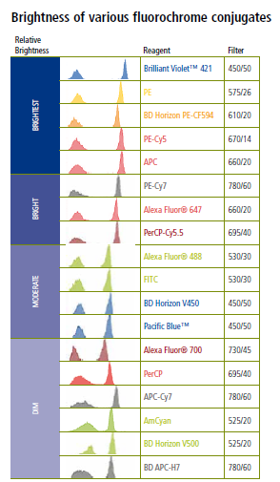
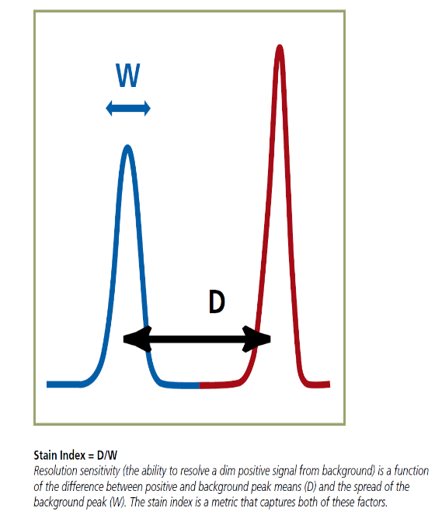
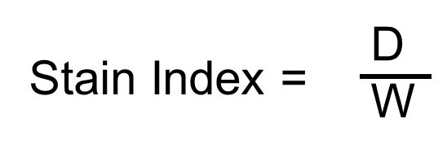

Stain Index-Fluorochromes Resolution
Bright= good resolution sensitivity

Slide 22
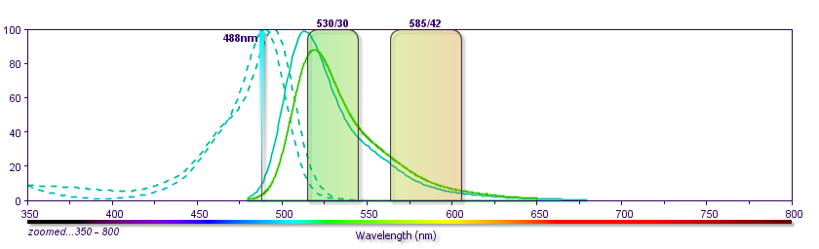
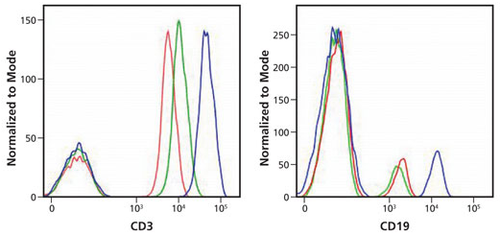
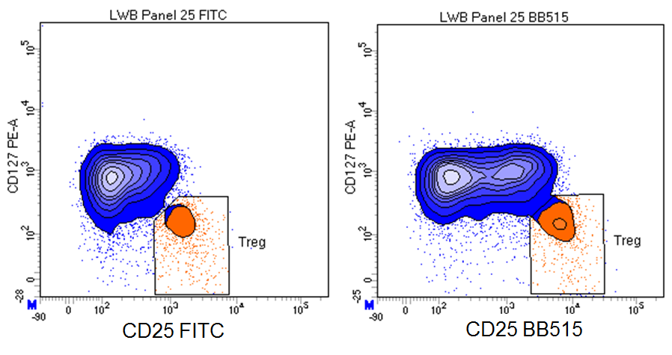
BD Horizon Brilliant Blue515 is better than FITC
BB515
FITC
Benefits
  Intensity: 7X higher than FITC
  Spillover: almost no to PE channel
  Less antibody usage : 5ul/test
  Available for all Flow Cytometers: detect at FITC channel
FITC
Alexa Fluor® 488
BB515

Slide 23
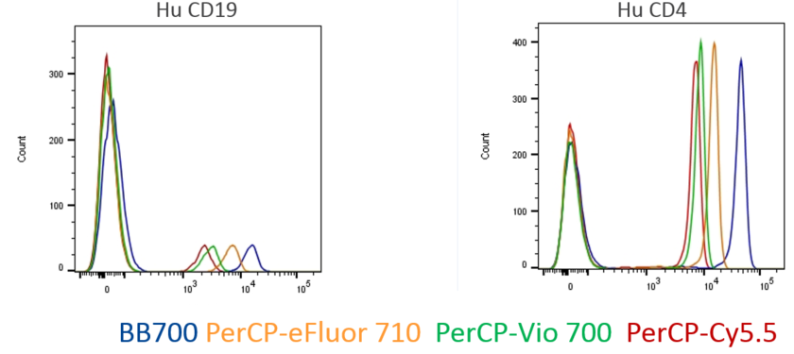
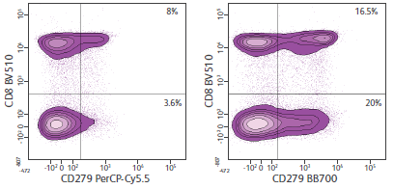
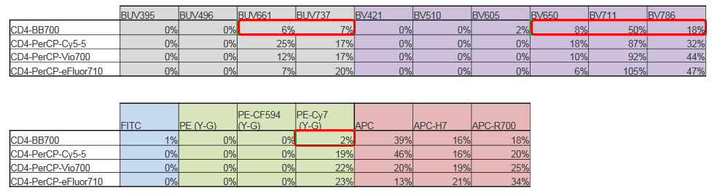
BD Horizon Brilliant Blue700-
Brighter and less excitation by other lasers

Slide 24
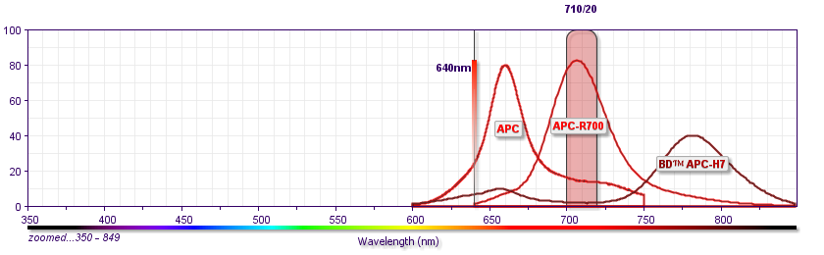
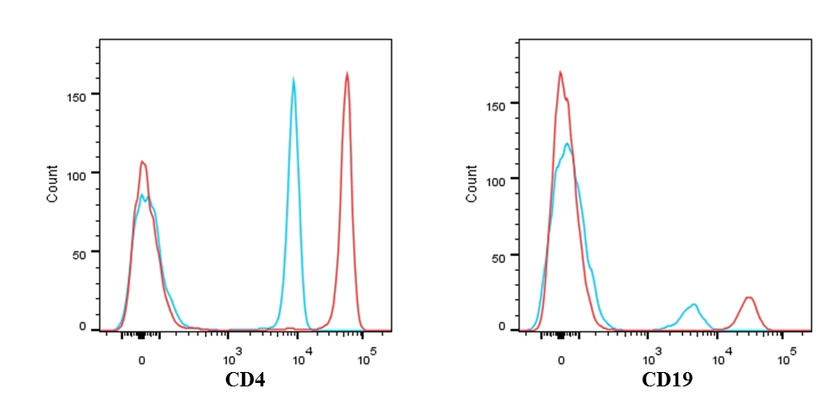
BD Horizon APC-R700- the substitution for AF700
Benefit
  Intensity：Higher than AF700
Alexa Fluor® 700
APC-R700

Slide 25
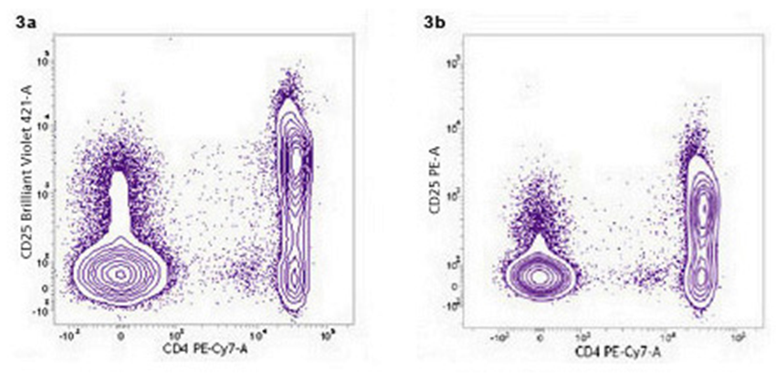
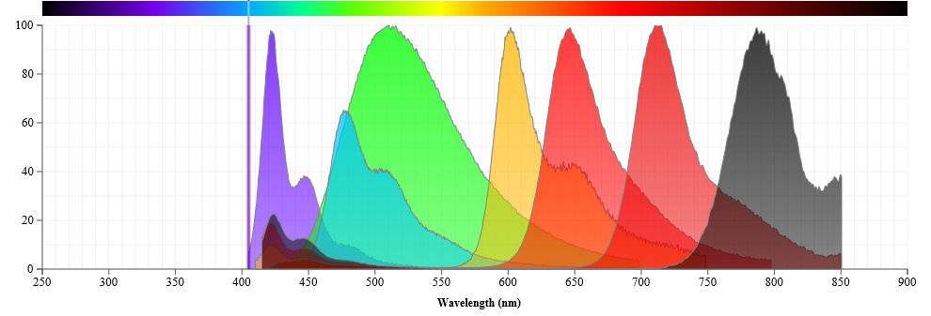
BD Horizon Brilliant Violet Dyes-expand 405nm laser functionality
Base polymers: BV421, BV480, BV510
Tandems: BV605, BV650, BV711,BV786
Benefits：
  Higher Flourescence Intensity
  Less Spillover to other channel
  Suitable for multicolor panel design
  Good at rare population detection
Highest stain index for BV421

Slide 26
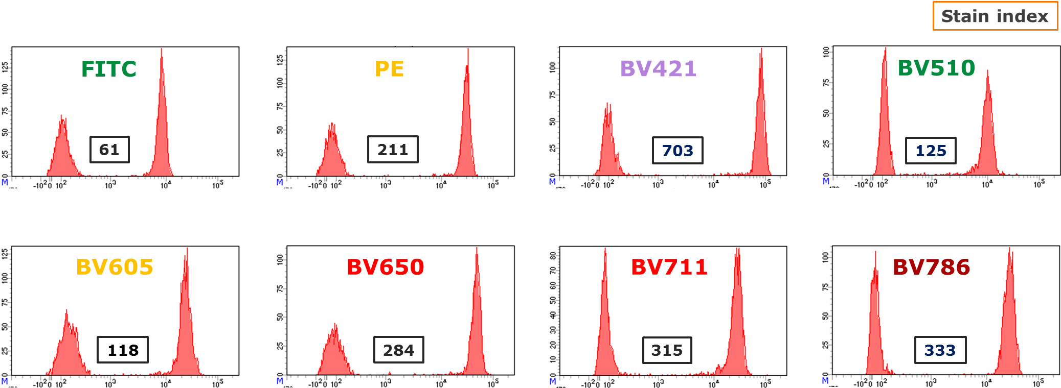
CD4-best resolution with BV421
Very Bright | Bright | Moderate | Dim
BD Horizon BV421 | BD Horizon BV605 | BD Horizon BV510 | BD Horizon V450
BD Horizon BV650 | BD Horizon BV786 |  | BD Horizon V500
BD Horizon BV711

Slide 27
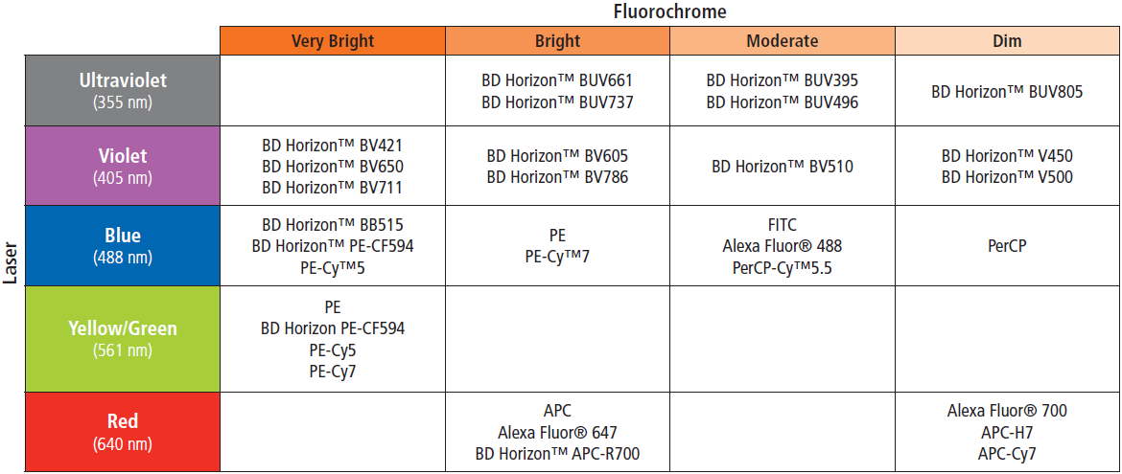
Intensity Ranking
Medium Express
Low Express
High Express
B480
BB700

Slide 28
Fluorochrome Choice is Key to Reveal Dim-expressed markers

Slide 29
Electronics
Optical signals are converted to electronic signals.
Voltage pulse height, area, and width are analyzed.
Analog signals are converted to digital signals.
Data is transferred to the computer.
Notes:
In this section we will be covering
how the optical signal becomes an electronic signal
how the electronic pulse is evaluated
how the pulse values are converted to digital values so that the computer can work with the data

Slide 30
Creation of a Voltage Pulse
Laser
Pulse Height
Volts
Time (µs)
Pulse Width

Slide 31
Quantification of a Voltage Pulse
Notes:
The cytometer can quantify voltage pulses one of three ways, which we briefly discussed earlier:
1 - Pulse height or peak height (when the maximum amount of fluorescent or scatter has been generated).
2 – Pulse area (integrated sum of all the height values for duration of pulse).
3 -Pulse width, time of flight (how long it took to get through the focal point of the laser beam).
The default analysis measurement is pulse area, which works best for most applications.

Slide 32
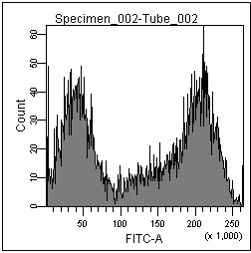
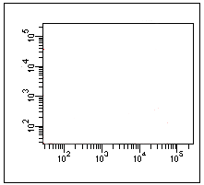
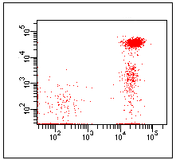
Data Storage
Histogram (1 parameter)
List-Mode Data
Time
FSC
SSC
FITC
PE
39,271
39,271
Event 1
0
60
120
89
675
Event 2
10
160
65
39,271
30,621
Event 3
30
650
160
22,688
6,189
Dot Plot (2 parameters)
Dot plot (2 parameters)
39,271
FITC
FITC
89
PE
675
30,621
PE
Notes:
When the computer saves the data from the cytometer, it is saved in a list mode format. List mode data contains a listing of the cell's parameters on a cell by cell basis; it contains no pictures, just a list of data.
If software is used that can recognize the list mode (FCS) data file, a dot plot can be created that will take two parameters and plot them against each other. On the dot plot we can see that after many single events are graphed together, populations start to emerge.
For Diva software data, the list consists of raw data with the compensation matrix stored in the same file. So, the matrix can be used to calculate compensation at any point. Because of this, we can turn compensation off or further compensate after the data has been collected.

Slide 33
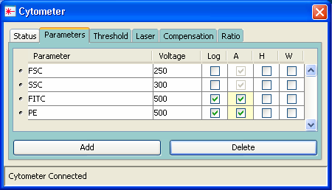
Data Display
Linear Scaling
Log Scaling
Notes:
Data can be displayed in FACSDiva software using one of three different scaling, linear, log, or biexponential. All data generated from the digital electronics is linear data with a range of 0-262, 144 (2¹⁸ -1). The linear values generated can be displayed within the software using linear, log, or biexponential scaling at any time, either before or after recording.

Slide 34
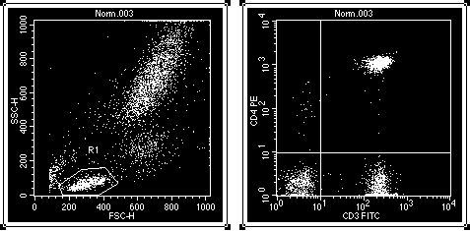
Linear v. Log Amplification
Linear amplification is usually used for light scatter parameters and DNA analysis (cell cycle).
Log amplification is used for fluorescence signals with a large dynamic range.

Slide 35
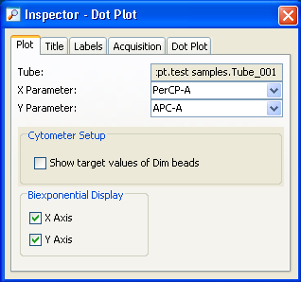
Biexponential Display
Biexponential Display checkboxes
Notes:
Turn on the biexponential display by selecting a plot and selecting the checkboxes in the Plot Inspector.

Slide 36
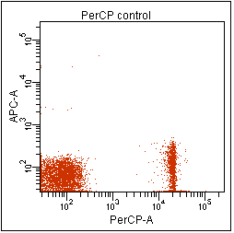

Log vs Biexponential Scaling
log scaling
biexponential scaling
Notes:
Point out how the negative population can be viewed in its entirety when the biexponential scaling is turned on. Compensation is much easier to verify visually on a biexponential scale

Slide 37
Compensation Theory
Emission Spectra: Spectral Overlap
100%
AmCyan
Pacific Blue
FITC
PE
PI
APC
PerCP
PerCP-Cy5.5
PE-Cy7
Normalized Intensity
0%
400
500
600
700
800
Wavelength (nm)
Notes:
When running multi-color samples, it’s important to calculate compensation to be able to measure each signal accurately.
We’ll spend a little time reviewing compensation theory before looking at the steps involved in calculating compensation.

Slide 38
Spillover
FITC
PE
585/42
PerCP-Cy5.5
695/40
PE-Cy7
780/60
530/30
Relative Intensity
500
550
600
650
700
750
800
Wavelength (nm)
FITC
PE
PerCP-Cy5.5
PE-Cy7
Notes:
This slide shows that using optical filters in front of detectors (point out blocks on diagram) does not solve the problem of spectral overlap. Because of spectral overlap, the emission from, for example, FITC spills over into the PE detector and falsely increases the PE signal. We refer to this as spillover.
The more fluorochromes you use in a sample, the more spillover effect you will have. (Point out PE into FITC, PE into PerCP-Cy5.5 etc). The goal is to remove the effects of spillover so that the data reported from each fluorescence detector is specific for its fluorochrome. Let’s look at this, one fluorochrome at a time.

Slide 39


FITC Spillover
FITC
PE
585/42
PerCP-Cy5.5
695/40
530/30
Relative Intensity
500
550
600
650
700
750
800
Wavelength (nm)
Notes:
Here is the FITC emission curve, along with the FITC, PE, and PerCP-Cy5.5 detector bandwidths. If we were dealing with a single-color FITC sample there would be no problem even though it is detected in the PE detector and PerCP-Cy5.5 detector, because we would only be using data from the FITC detector.
If we were running a multicolor sample however, we would need to compensate to correct for the spillover of FITC emission into the PE and PerCP-Cy5.5 detectors. The plot shows what an uncompensated single color FITC population typically would look like. You can see that although there is no PE or PerCP present, the population looks positive for those two fluorochromes. We use compensation to ensure that the reading we get from those two detectors will not be “contaminated” by spillover from FITC when we analyze a multicolor sample.

Slide 40



FITC Compensation
FITC
530/30
PE
585/42
PerCP-Cy5.5
695/40
Relative Intensity
500
550
600
650
700
Wavelength (nm)
Increase values
Notes:
(Point to plots) Again, the plots show how FITC spills over into the PE and PerCP-Cy5.5 detectors. Compensation corrects for these spillovers. When it is applied correctly, the population will move in the direction shown so that it only reads positive for FITC.
To achieve correct compensation, the values in the Spectral Overlap column (point to table heading) need to be increased.
NOTE to instructor: with digital compensation, avoid using the term “subtraction” because it’s more than just a subtraction. Refer to instructor’s notes at end of compensation lesson plan for details.

Slide 41





FITC Compensation
To lower cluster, increase value.
FITC
530/30
PE
585/42
PerCP-Cy5.5
695/40
Relative Intensity
500
550
600
650
700
Wavelength (nm)
Notes:
Let’s take a look at how FITC spillover into the PE detector is corrected.
Compensation is optimal when the mean of the FITC cluster equals the mean (or median) of the negative population (point to PE axis). In other words, the FITC population has no more PE fluorescence than the negative population. When compensation is correct, the FITC cluster shows positive in the FITC detector and negative in the PE detector. In this example it was necessary to correct for the FITC spillover into the PE detector by adjusting the PE – % FITC Spectral Overlap value.
The values that are listed under Spectral Overlap are actually the spillover values. For example, 20.10% of what is detected in the FITC channel, is detected in PE. The software uses these values to calculate and apply the compensation required to correct for the spillover. For details on how it’s done, you can read the FACSDiva white paper.

Slide 42



Compensation Examples
Incorrect Compensation
Correct Compensation
Undercompensation
Overcompensation
Notes:
Optimal Compensation is achieved when the mean of the single positive population is equal to the mean of the negative population.
Under-compensation is the case when the single stained population shows up as a double positive and the mean is higher than that of the negative population. In this case you must remove more FITC spillover signal from PE, so you would increase the PE – %FITC Spectral Overlap value.
Overcompensation is when mean of the single positive population is lower than that of the negative so that the population aligns below or to the left of the negative population. In this case you have overcorrected and removed too much signal. To correct this problem you would lower the PE – %FITC Spectral Overlap value.
The important thing to remember is that visual inspection of plots is not the final check for determining if compensation if optimal, because they can sometimes be misleading. Comparing population means or medians is the only objective way to determine if compensation is correct.
The good news is that with BD FACSDiva software there is really no need to perform compensation manually because the software can automatically do it for you. If for some reason you need to perform compensation manually though, it’s important for you to be able to determine if it is correct.

Slide 43


Review
3. Electronics
Time
1. Fluidics
SSC
Time
Data Processing
FSC
Time
PE
FITC
Time
APC
2. Optics
Time
PerCP-Cy5.5
Time
Notes:
In review, flow cytometry is a technology that simultaneously measures multiple physical characteristics of single particles, usually cells.
The flow cytometer uses a combination of fluidic, optical, and electronic systems to measure particles individually and to collect data for subsequent analysis.
The information obtained includes a particle’s relative size, relative granularity or internal complexity, and relative fluorescence intensity.
These characteristics are detected using an optical-to-electronic coupling system that records how the particle scatters incident laser light and emits fluorescence.
Particles must be in suspension to be analyzed on the flow cytometer. Blood cells are ideally suited for analysis because they are already in suspension. Cells from solid tissue must be disaggregated prior to analysis.
In a flow cytometer, particles are carried to the laser intercept in a fluid stream.
The portion of the fluid stream where particles are located is called the sample core stream.
When the particles pass through the laser, they scatter laser light and any fluorescent molecules present on the particle will fluoresce.
Appropriately positioned lenses collect the scattered and fluorescent light. A combination of beam splitters and filters route the scattered and fluorescent light to the appropriate detectors.
The detectors produce electronic signals proportional to the optical signals striking them.
Data are collected on each particle or event.
The characteristics or parameters measured on each event are based on its light scattering and fluorescent properties.
The data are collected and stored in the computer.
These data can be analyzed to provide information about sub-populations within the sample.

Slide 44
Applications
Phenotype Analysis (Cell Surface Antigens/Markers)
Intracellular Analysis
-- Eg. Cytokines, Signal Transduction molecules…etc.
DNA Analysis
-- Eg. Viability, Cell cycle, Apoptosis…etc.
Cell Function Analysis
-- Eg. Free radicals, Ca²⁺, Reporter genes…etc.
CBA (Cytometric Bead Array)

Slide 45
Phenotype Analysis
Ligand
Receptor
Adhesion molecule
…etc

Slide 46
Lymphocyte Immunophenotyping
Peripheral White Blood Cells
CD45⁺
Monocytes
Granulocytes
Lymphocytes
Neutrophils
Monocytes
T
B
NK
CD3⁺
CD3⁻
CD16⁺
CD56⁺
Basophils
CD3⁻
CD19⁺
T
Helper
T
Cytotoxic
Eosinophils
CD3⁺
CD4⁺
CD3⁺
CD8⁺

Slide 47


Slide 48
Signal Transduction

Slide 49
Intracellular Staining in Activated Lysed Whole Blood

Slide 50

Cell Cycle
2N
4N

Slide 51





Apoptosis (Sub G1)

Slide 52

Annexin V Apoptosis Assay

Slide 53

Annexin V/PI Double Staining
Bordón et al. Radiation Oncology 2009 4:58
Notes:
Lower left; Lower right
Upper Left; Upper right

Slide 54

Cytometric Beads Array (CBA)
Single Step
Incubation
or
Two-Step
Incubation

Slide 55
Beads Provide a Flexible Platform
Multiple sizes
Different fluorescence
intensities
Different colors with different intensities

Slide 56
Advantages of Bead-Based Immunoassays
(compared with ELISA)
Analyze multiple analytes simultaneously
Reduced sample volume requirements Reduced hands-on time
Wide dynamic range of fluorescence detection

Slide 57


6-plex Cytokine detection
Proteins Measured
A. Interleukin (IL)-2
B. IL-4
C. IL-5
D. IL-10
E. Tumor Necrosis Factor-α
F. Interferon-γ

Slide 58

Cytometry Beads Array (CBA)

Slide 59
Standard Curves

Slide 60

Question?

